Slide 1
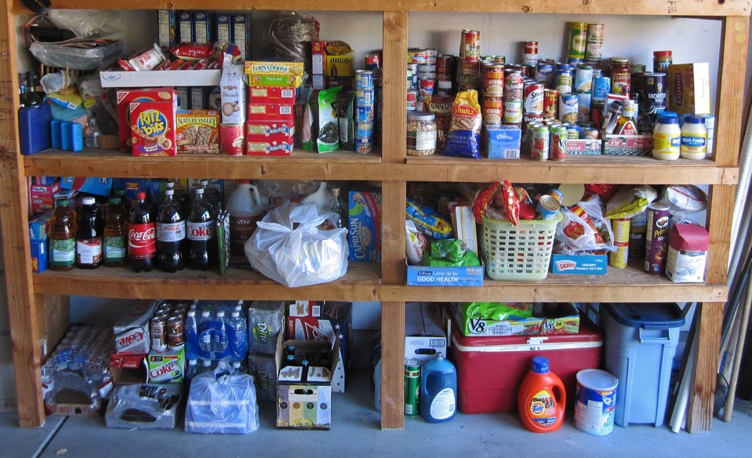



Designing a new food security experience in Del Norte
October 2017

Slide 2
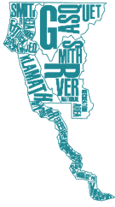
Introduction
In Del Norte County, food insecurity has many faces. One of these faces is a parent who goes to bed hungry, having given the little food she had in her pantry to her child. Another is the face of a foster child, who steals food from his foster parents because he grew up not knowing the next time he would be fed. Yet another face of food insecurity in Del Norte is a homeless woman, who shares food with her fellow homeless residents.
These are some of the facets of food security that the Community Food Council learned about when researching food security in Del Norte. Our research was based around the use of empathy interviews. In an empathy interview,
the researcher asks for the interviewee to tell their personal story about the topic of interest. Using this approach, our team interviewed 25 Del Norte residents. Approximately half of these interviewees were experiencing, or had recently experienced, food insecurity in Del Norte. The other half had jobs focused on providing local food security services.
Each of these interviews was transcribed, with notes taken during and directly after the interview. We analyzed the interview transcripts by reviewing them for key themes and quotes. From this analysis, we gathered nine key themes regarding the experience of food insecurity in Del Norte. To complement this analysis of the individual’s experience, we also created a systems map of food security in Del Norte. The systems map displays the resources, and gaps in resources, that influence food security in our community.
This report summarizes our empathy research findings and outlines a blueprint for change. In having gathered a deep analysis of food insecurity in our community, our goal is to take well-informed action to increase food security. We take time at the end of the report to identify next steps the Community Food Council will take in response to our research findings.

Slide 3



The process
Analyzing what we heard and mapping the system
Creating an interview protocol packet and training interviewers
Recruiting interviewees and conducting interviews
Creating profiles and mapping their experience
Generating ideas and prototyping new ways to improve the user experience
To understand the experience of food security in Del Norte, our team utilized an empathy approach. This approach involved designing a robust research approach, conducting empathy interviews with people using Del Norte’s food security system and those working in the system, and analyzing the interview data. From the interview analysis, we developed personas to bring to life the characteristics of the people we spoke to, mapped the food security experience for these personas and identified the system shifts required to make a new food security experience a reality for people interacting with, and working in, the system. Our final step was to generate ideas to create this future experience and prototyped ways to improve the food access experience for our personas. This process enabled us to understand Del Norte’s food security system from a user perspective and address their pain points.

Slide 4
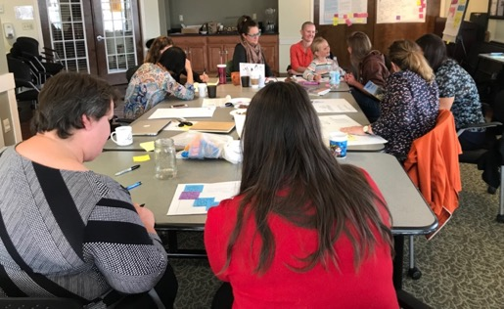
Who is involved?
Building Healthy Communities (BHC)
BHC is driving the food security project and coordinates effort with other streams of BHC work. The food security project fits into BHC’s larger work of improving health outcomes for residents of
Del Norte and Tribal Lands.
Food Security Core Design Team
The food security core design team is a combination of food security service providers, tribal employees, health care professionals, community workers, and educators. This group is using the empathy insights and blueprint for change to understand and address food security in Del Norte.
School Systems Implementation Team (SSIT)
SSIT, consisting of educators, business leaders, parents, and non-profit organizations is building
a stronger Del Norte County through a strategic partnership with a shared commitment to guarantee that all students are contributing community members prepared for college and career.
The team is committed to our work being a continuous process; a promise for ongoing communication, dialogue and engagement;
and the belief that we must work collectively in order to be successful.
4

Slide 5
Interviewee Summary
In total, we conducted 25 interviews. These interviews were split into two main groups:
Food insecure individuals
Local food security service employees
For food insecure individuals, we spoke with families and individuals from Smith River to Klamath. Our goal was to conduct a mix of interviews as geographically, ethnically, and socioeconomically diverse as possible. We interviewed Hmong families, Hispanic families, Native American families, Caucasian families, senior citizens, parents of young children, homeless individuals, and foster parents.
In terms of food security employees, we spoke to the leadership of many organizations including: the Director of Nutrition Services at Del Norte Unified School District, the Director of the Rural Human Services Food Bank, the Director of SNAP-Education, and the Director of the Tolowa Elder Nutrition Services. We also spoke to organization staff who provide services directly including: foster parent support staff, veteran service providers, food bank employees, WIC staff, schoolteachers, and SNAP enrolment specialists.

Slide 6
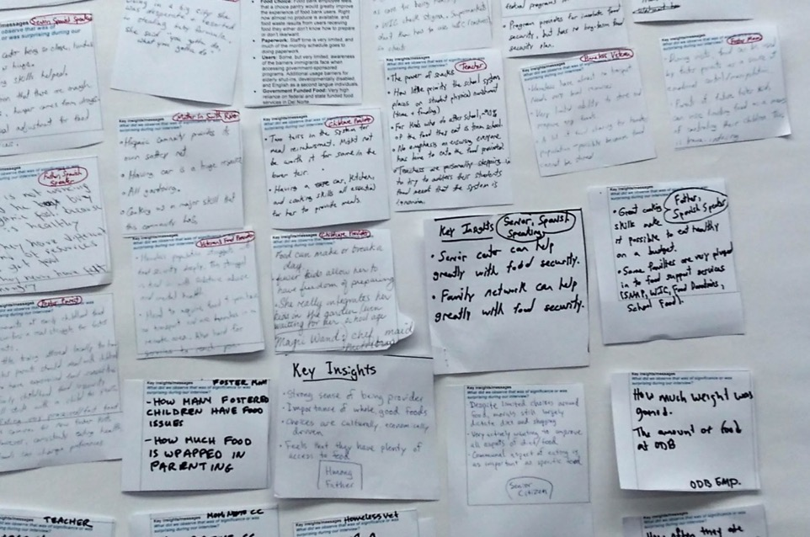
FOOD INSECURITY FINDINGS

Slide 7
Key Themes
A total of nine key insights emerged from our research analysis. These insights help illustrate the experience of being food insecure in Del Norte.
Cooking and nutrition education is needed to increase food security
Food-based trauma can
last a lifetime
Eating well while homeless has unique, extreme challenges
When relying on food services, accessing food requires a full-time effort
Local food service organizations struggle
to maintain
funding and support
Food sharing builds family and community support networks
Parents will provide food for their families at all costs
Many children rely on school meals, but the
system has gaps
Food insecurity services run on a complicated monthly schedule

Slide 8
1
Cooking and nutrition education is needed to increase food security.
–
Residents of Del Norte can often obtain sufficient food from local food security services providers; however, families don’t know how to cook many of the foods they receive. Education on cooking and nutrition is severely needed.
“We were doing some food cooking classes using what we give in a commodities box, so they would know how to use them. A lot of people don’t know how to. They don’t know how to cook a bean. It’s like ‘What do you do with them?”
– Food Bank Employee
“I have parents that come in here that don’t even know how to make mac n cheese. They can’t boil an egg.”
– WIC Provider
“Yeah, WIC gave us good tips. I was anaemic when I was pregnant so they encouraged me to eat foods that would keep my iron up.”
– Smith River Mother
“Part of the requirements of people with kids in foster care… part of their training is to incorporate basic cooking.”
– Foster Mom

Slide 9
2
Food-based trauma can last a lifetime.
–
Food-based trauma is prevalent in foster children and often expresses itself as hoarding, overeating, and stealing. Foster parents struggle to manage their children's relationship with food and food can be a source of tension with biological parents. The effects of food-based trauma can last well into late teens and adulthood.
“My foster child is a food hoarder - I find wrappers in her bedroom all the time. When I cook, I have to give her a snack; otherwise she seems anxious that she won’t get to eat what I’m cooking. Things get worse when her Dad brings McDonalds to visitations. Then she won’t eat my dinner but will cry before bedtime that she’s hungry.”
– Foster Parent
“It’s a guilt thing. They’re going to provide treats out of guilt. It’s how they love their kids, it’s through treats, through ice cream.”
– Foster Parent
“I don’t think [foster children] ever break these habits.”
– Foster Parent
“They’ll hoard food then eat until they throw up.”
– Foster Parent
“When it comes down to it, once a child is in foster care the biggest thing that a parent can do it control the food [at visitation]. That’s the only thing they have let to control.”
– Foster Parent

Slide 10
3
Eating well while homeless has unique, extreme challenges.
–
Without a safe place to cook, refrigerate, or store food, homeless individuals face an added layer of logistical challenges around accessing food resources and eating well. Figuring out where and when food is available and dealing with transportation, storage, and safety is extremely challenging.
“I’m homeless… you almost have to cook everything you get right away. You don’t want to waste it, so you share it with everybody. I don’t have any way to keep it.”
– Homeless Veteran
“Being homeless with two daughters, 8 and 10 years old, Our Daily Bread fed us breakfast, lunch, and dinner.”
– Remote Resident
“When someone is homeless, their mail goes to the general delivery post office box. They may not be getting their mail. That’s quite possibly the only way [to recertify for SNAP] other than trying to beat the bushes.”
– SNAP Employee
“Availability of cooking facilities, or a way to cook, is the number one problem I think, amongst the homeless population.”
– Homeless Veteran

Slide 11
4
When relying on food services, accessing food requires a full-time effort.
–
Since each food service organization in Del Norte has a different schedule and location, it can be almost impossible for families to make it to all the different places food is available; especially when traveling with kids, working, and dealing with limited transportation and bad weather.
“They have to bring the child in. It’s difficult if they’re working or if they have no transportation.”
– WIC Provider
“It’s hard if they don’t have the capabilities of carrying all of that, which we do have a lot of people who are on foot… I’ve had people who have come by and actually dropped off their milk.”
– WIC Provider
On their top food access challenges: “Transportation. Time… what time of day it is and whether you have time to do it. That’s where that transportation comes into effect.”
– Homeless Veteran
“I have to keep track of so many things.”
– Senior Citizen

Slide 12
5
Local food service organizations struggle to maintain funding and support.
–
Virtually all organizations that provide food services struggle with two major issues: lack of funding and limited staff/volunteer support. Some local food security organizations operate at a loss, while others risk being scrapped entirely. Volunteers are needed everywhere, but good volunteers are hard to find and keep.
“Last month we did over 700 boxes of food out of this room. That was just our food bank. That didn’t include our emergency food boxes, senior boxes, or homeless program. We put a lot of food through this room.”
– RHS Food Bank Employee
“We’ve been asking for help, and it’s a little bit difficult sometimes to get volunteers to come in. Some of our elderly have gotten to the point that they can’t assemble food boxes.”
– RHS Food Bank Employee
“There is a federal program where if you’re getting a CalFresh benefit then you can get a job and then you’re working for your CalFresh benefit. That’s not something we instituted here [in Del Norte] because there just wasn’t enough money.”
– SNAP Employee
“Yes. It's hard to run a school nutrition program with the revenue that we're getting in terms of the reimbursements when cost of food and cost of labor are so expensive. There are very few programs that I'm aware of that run in the black. .”
– DNCUSD Nutrition Services Employee

Slide 13
6
Food sharing builds family and community support networks.
–
Many families appreciate the value in building a network of support within their community for food and resource sharing. Sharing ingredients and meals relieves some food security pressures and helps build supportive relationships.
“Yes. That (sharing meals) is the best way to do it. That way, we don’t waste anything and everybody gets something to eat. We just take anybody that’s around and share it with everybody.”
– Homeless Veteran
“Yeah, a lot of people are from the same town in Mexico so we all know each other (talking about sharing meals with neighbors).”
– Smith River Mother
”I have a friend who is the Soup Queen. She’s going to give me soup today.”
– Senior Citizen

Slide 14
7
Parents will provide food for their families at all costs.
–
For many families, deeply held cultural beliefs and values are a primary driver for how they approach things like obtaining food, cooking, and utilizing food security services. Across cultures, parents share a desire to provide food for their family regardless of how challenging this task may be.
“I will go to any lengths to feed my family. This has included breaking the law as well as working with the food access system.”
– Mother of Three
“My family does not go hungry. I always provide enough food.”
– Hmong Father
“I feel like I don’t ever want my kids to think that we don’t have food.”
– Mother, New to Crescent City

Slide 15
8
Many children rely on school meals, but the system has gaps.
–
School food services provide an extensive array of healthy meals to Del Norte students. However, there are many logistical difficulties that prevent children from being consistently well- fed. Limited time to eat school meals, a lack of snacks, small meal sizes, and students not having enough money to purchase meals can all contribute to a child not accessing enough food while at school.
“Sometimes we’re quick to discipline when behaviour starts escalating, but sometimes, if you know very much about the family, you can solve the problem more easily by giving the child some food. To this day, it’s always something I’ve paid attention to.”
– Teacher
“They get the same portion as a kindergartener would; and in my opinion, for a fifth grader, that’s not adequate. They’re still hungry.”
– Teacher
“Many of my students are here from 7:20 until close. The [after school] program ends at 6. All of their food for the day is provided by school.”
– Teacher
“They like to go to school because they know they get to eat at school. They don’t always know when they get to eat at home.”
– Foster Mom
“The biggest problem is if they get in there to eat breakfast and the time runs out, so they have to throw it away.”
– Teacher

Slide 16
9
Food insecurity services run on a complicated monthly schedule.
–
Many families and individuals who access food resources run out of food before the end of the month. It is hard work to get to all the places that offer food on the right day -- and there’s often just one day per month when services are available.
“[Parents] don’t know how to budget for food. At the first of the month the kids will get a lot of food - not necessarily nutritious food. Then as the month goes on, there’s less money. There’s less food.”
– Foster Mom
“At times, I’m like ‘Oh man’ but there’s really nothing in there to eat and I really need to go grocery shopping, but I can’t yet.”
– Mother
“I mean, if it wasn’t for what I got I don’t know how I’d make it to the end of the month, financially. I feel real blessed to be here and real blessed to get the commodities and food stamps”
– Senior
“It’s more towards the end of the month when things are getting strapped and real tight.”
– Mother, New to Crescent City

Slide 17
Critical System Shifts
Shift Area
Current State
Future State
Promote cooking, gardening, nutrition,
and budgeting education
While a lot of food is available in Crescent City to those who need it, education around nutrition and how to prepare healthy, affordable meals is needed
All families and individuals know about the importance and benefits of nutrition, cooking and budgeting
Improved transportation options
It is hard for families/individuals to access and coordinate transport to the multiple times/locations for food access
Public transportation is more readily available and coordinated with food service dates/times to facilitate the use of these services
Food assistance services are complicated and difficult to access, leaving people hungry at the end of the month when they run out of food resources
Clients are fully knowledgeable about, and can easily access, all of the services in Del Norte, ensuring that they receive enough food throughout the month
Well-designed access points and services
Understanding, applying/reapplying for, and trying to make monthly benefits last, is a constant struggle for people. The redemption experience can be disempowering for individual and families
Benefit systems and processes are easy to understand and access. Individuals and families are supported and empowered so they can effectively manage their benefits and food supply for the whole month
Enhanced benefit user experience
Enduring provider capacity
Local food services struggle to sustainably maintain volunteer support and funding
Our food service providers are well staffed, supported by reliable volunteers and are well funded

Slide 18
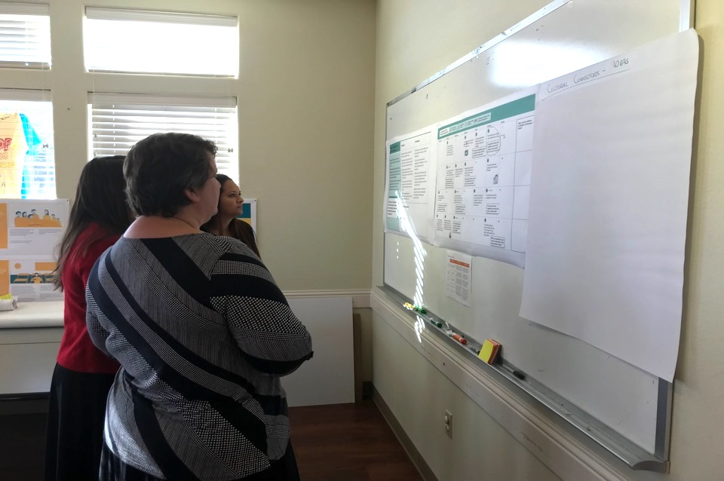
People profiles and experience maps

Slide 19
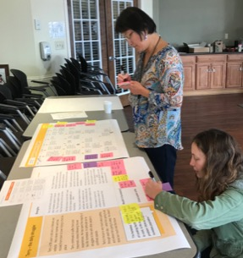
People profiles
Profiles are a representation of the goals, characteristics and behaviors of a hypothesized group of customers. Profiles are an important design tool to help create services and experiences for different kinds of people. We developed five profiles, bringing to life the strengths and challenges for each grouping. We also thought about what a transformed food security system could look like for each profile, and what needed to be different in the system to make this a reality.
Each profile is supported by an experience map, depicted as a monthly calendar, which illustrates the current journey of people interacting and engaging with the food security system. A key insight from the empathy research was the food security system is based on a monthly cycle, which makes it challenging for people to effectively manage their benefits and food supply for the whole month. The monthly calendar experience maps were developed to bring these challenges and pain points to life.

Slide 20


Tina
The exhausted juggler
Strengths
Challenges
Tina puts all of her energy into the daily pre-school, school and baby routines as well as after school activities
Tina is able to keep going despite all the challenges she faces
While Tina has limited cooking skills she is learning about cooking and nutrition
The support Tina receives from WIC
is a lifeline for her
Her older child receiving nutritious food at school has made a big difference and helped reduced Tina’s stress levels
Tina prioritizes feeding her children over herself, so sometimes she goes hungry
Navigating the various systems to access food and other services feels like a full time job for Tina at times
Tina doesn’t drive and there’s limited public transport options for her and the children
She has few support networks, and the challenge of keeping her family going by herself is often overwhelming
Tina is mentally exhausted with the struggle of getting by each day
Tina is a single Mom with three children, aged 5, 3 and 9 months, living in a trailer at Bertsch Tract
Tina’s priority are her children. She worries about them and works hard to make sure they have what they need
She feels it’s a consistent battle keeping on top of things for her family, especially ensuring the children are well fed and cared for
“I feel like I don’t ever want my kids to think that we don’t have food. I will go to any lengths to feed my family. This has included breaking the law to get formula for my baby as well as working with the food access system.”
Wouldn’t it be amazing if:
Benefits are given out twice a
month, instead of monthly
Families could access affordable housing with proper kitchens
Public transit was available, supported by co-ordinated neighborhood transportation
People who receive food services were given tailored information and education about cooking and nutrition
There were mobile markets that went to neighborhoods
Families knew about all the food resources that are available to them

Slide 22
Margaret
The thrifty Elder
Strengths
Challenges
Margaret knows how to cook nutritious meals on a budget. She cooks up meals at the start of the month when her payment comes in, then freezes these to help her get through to the end of the month, when the money is tight
Margaret is thrifty and is able to make her limited resources go a long way
Margaret does get some support from other seniors in her area, which is critical as she can’t get out and about very often
She’s a Tolowa Dee-ni’ tribal member and qualifies for their meals program
Margaret misses her family and often feels isolated, especially over the winter months when she can’t get out much and eats most of her meals alone
As Margaret has limited mobility she has to rely on others to get into the city to attend appointments and access services. Margaret likes to be self-sufficient so struggles at times relying on others for help
While Margaret does receive fixed retirement payments it’s often not enough to make ends meet, so she has to carefully watch her monthly expenses. This is stressful, especially at Margaret’s stage in life
Margaret, who is 80, has lived in Smith River all her life. Her children moved away from the area a long time ago, she still misses them every day
Margaret has limited resources and relies on fixed retirement payments to get her through each month
With her limited mobility and access to transport, Margaret finds it challenging to access the services she needs
She’s on the waiting list for home delivery from the Howonquet Senior Nutrition Program
Wouldn’t it be amazing if:
“If it wasn’t for what I got I don’t know how I would make it to the end of the month financially. I have to keep track of so many things.”
People who have budgeting and cooking skills and knowledge were able to be paired up with other individuals or families who need support
There was expanded capacity for home food delivery services and there were no waiting lists
There was a Tolowa Tribal transit service for accessing food resources
Traditional foods were more available to families
Land access and wildlife/fisheries management policies allowed for more Tribal gathering

Slide 23
A monthly food cycle for Margaret
Lives at home in Smith River
Tolowa Dee-ni’ tribal member
Limited mobility and access to transport
Relies on fixed retirement payments
Monday
Tuesday
Wednesday
Thursday
Friday
Saturday
Sunday
1
2
3
4
5
6
7
Margaret thinks about catching the bus to go to the grocery store, but she is too tired to make the trip.
Margaret wants to make some soup for the week. She phones her friend to see if she can get a ride tomorrow. She plans on using her coupons.
She gets a ride with a friend to the store.
“Wow, groceries seem to be more expensive all the time, but my income stays the same.”
8
9 Isolated
Margaret gets a senior farmers market coupon. She can’t find a ride for this week so misses out.
10
11
12
13
14
Her son comes from out of town for a weekend visit.
Margaret’s son takes her out for the day to see the ocean.
“I wish my son didn’t have to leave today. It’s nice to have someone in the house and to share meals with him.”
“It’s so nice to have someone cook and bring groceries.”
“I miss fishing and gathering acorns. I am too old to gather traditional foods.”
15
16
17
18
19
21
Margaret calls to see where she’s on the waiting list for home food delivery.
Her friend takes her to Fred Meyer to shop.
“I hope I make it to the top of the list soon. It sure would be nice to have
someone stop by each day.”
“I wish we had gone to Grocery Outlet. I could have bought more with my money.”
22
23
24
25
26
27
28
A neighbor stops by for a visit. They drop off a casserole and some fresh berries.
“I’ve got some leftover casserole. I will turn that into a new meal for lunch.”
Margaret thinks about going back to Howonquet for lunch, but it’s raining and she’s tired.
Margaret finds a ride to the farmer’s market and uses her coupons.
“These fresh veggies will really help. I will make soup.”
23
23

Slide 24
Natalia and Rodrigo
The cultural connectors
Strengths
Challenges
Natalia and Rodrigo care deeply for their family and their culture
Preparing and cooking food for their family and community is an important way of keeping culturally connected
Making connections with other Hispanic families has been a life line - providing food and support while they find their feet
They have a car, which is critical to getting to and from work and being able to attend activities, events and church
They’re knowledgeable about gardening and are starting up a home garden with support from Open Door
The small pay increase Natalia has received impacted the family’s SNAP entitlements
They’ve found the process of reapplying for entitlements in a new county confusing and time-consuming
While some of the families they’ve met have told them about services, they’re unsure whether they’re accessing everything they could be to help their family
Settling the children in to their new schools has been hard, especially with Natalia and Rodrigo both working full time
Natalia and Rodrigo recently moved to Crescent City from LA with their two boys aged 9 and 15
Both Natalia and Rodrigo work full time. Natalia got a pay increase with her new role in the city and the family have lost some of their entitlements
They are finding it difficult to know what’s available to them and have found it confusing needing to reapply for entitlements
“We’ve met a lot of people from the same state in Mexico so we’re getting to know them through sharing meals with our neighbors.”
Wouldn’t it be amazing if:
If families were able to save more
to get them through emergencies
There was a grace period in relation to entitlements when people receive a pay increase
All neighbors watched out for and supported each other
There was a minimum basic income for all
Services were open longer hours to accommodate parents who work full-time

Slide 25
A monthly food cycle for Natalia and Rodrigo’s family
Recently moved to Crescent City
Both parents working
Reduced SNAP eligibility
Food being provided by other families at times
Monday
Tuesday
Wednesday
Thursday
Friday
Saturday
Sunday
1
2
3
4
5
6
7
Rodrigo is picked up by a co-worker at 5am for his job at a farm in Smith River, where he works six days a week.
Natalia gets her first pay check which includes her pay raise.
The family celebrates Natalia’s pay raise by cooking a large meal together.
The family goes to watch soccer games at La Joya.
“Our sons are getting good at cooking this dish, we don’t even need to help them.”
8
9 Anxious
The family loses some SNAP entitlements because of Natalia’s rise.
10
11
12
13
14
Natalia and Rodrigo are unsure if their boys will still qualify for free or reduced lunch.
Natalia is worried about visiting the SNAP office. A co-worker tells her about the Promatores at Open Door.
The Open Door Promatores meet with Natalia and Rodrigo at their home to help with their SNAP case and talk about home gardens.
The family does their weekly grocery shop at Safeway.
“We’re not sure if there is another program we might qualify for and we don’t know who to ask.”
“When will I have time to get to the SNAP office, I only have a 30 minute break?”
15
16
17
Worried
18
19
20 Thankful
21
Natalia and Rodrigo plan to plant their garden.
The family car breaks down. A family friend gives Natalia a ride to work, and drops the boys at school.
Natalia has to pick up the car early from the mechanic. The boys missed breakfast at their school.
The family gets invited to a neighbor’s for tamales.
“It’s going to be great to have our garden up and running. It will help with the food bills.”
“How much will the car cost to fix? $500? I’m not sure how we can afford this.”
“It’s so nice to have neighbors to share food and our culture with.”
22
23
24
Stressed
25
26
27
28
The family budget is very tight with the unexpected car bill. There isn’t much money left over to buy groceries for the week.
Natalia and Rodrigo’s neighbors bring over a basket of food. They heard about the car break down and wanted to help.
Natalia and Rodrigo have heard about the food bank, but they
can’t go as it’s only open during working hours.
“The summer break is nearly here. Feeding the boys is going to be a struggle.”
The family attends a potluck meal after their church service.
“We’re so grateful for our church community. They help us feel at home.”
25

Slide 26
Terry
The daily struggler
Strengths
Challenges
Terry has formed a community with other homeless people in Crescent City. They come together to share their food and look out for each other
His food sources include SNAP, meals from the Veterans Affairs and food sharing
Terry has a small network of friends,
in particular other veterans who care about him. He sometimes stays with friends for a couple of nights at a time
Terry is aware of some of his entitlements as a veteran, and occasionally accesses these
Terry’s biggest challenge and frustration is not being able to access the right kind of food as he has limited access to cooking facilities and nowhere to store the food he is given
The SNAP re-enrollment process is a pain point for Terry, and not having a permanent address means added complications
Not having access to transport is a major issue for Terry. Whether he can access food supplies on any given day
is often impacted by the weather
Terry’s daily struggles with mental health and addiction makes accessing any food services harder
Terry is 65 year’s old and a Vietnam war veteran. He’s never married and has moved from town to town trying to find his place
Terry continues to suffer from post traumatic stress following his war experiences. He has spent the majority of his life homeless as he struggles to live with other people in confined spaces
Terry’s focus is very much about getting through each day – what he’s going to eat and where he’s going to sleep. He doesn’t think too much into the future
“I’m homeless. The availability of cooking facilities, or a way to cook, is the number one problem I think amongst the homeless population.”
Wouldn’t it be amazing if:
Del Norte had a shelter and a Housing First program
Food, shelter and mental health support was available in the same place
Veterans received wrap-around services
More facilities and services were provided for homeless people - shared kitchen facilities, lockers to keep belongings safe, mail boxes, a shared bike program

Slide 27
A monthly food cycle for Terry
Homeless
Eligible for SNAP
Has mental health challenges
Monday
Tuesday
Wednesday
Thursday
Friday
Saturday
Sunday
1
2
3
4
5
6
7
Terry spends the night in the doorway. He gets woken up in the middle of the night by police.
He can’t get back to sleep afterwards so spends the rest of the night walking to stay warm.
Terry goes to see if the food bank is open. It’s not.
He finds a group of
other homeless residents cooking on the beach.
He joins them and gets a meal.
Someone gives Terry an old sleeping bag to use.
Terry goes to Safeway and uses his EBT card to buy two sandwiches.
It rains overnight and all of his belongings get drenched.
“Where am I going to find food today?”
“My leftover sandwich is soggy, I was looking forward to eating it.”
8
9 Defeated
Terry’s bike and bag got stolen overnight. His EBT card was in there.
10
11
12
13 Distresed
14
Terry is tired and frustrated. He runs into an old vet friend who offer’s him a bed for the night. He takes up this offer.
He goes to see if the food bank is open. It’s not.
Terry goes to Our Daily Bread
Ministries for a meal.
He plans on going in to get a new EBT card. It’s raining and he can’t motivate himself to walk there.
“Where will I find food today?”
“Last time this happened it took some time to get a new card.”
“I’m grateful for the meal, but I wish I didn’t feel so judged.”
“I wish I still had my bike or better yet my card.”
15
16
17
18
19
20 Thankful
21
Terry hears that the food bank is open tomorrow. He plans to go in the morning.
It’s raining, but he walks 3/4 mile to the food bank anyway. He is hungry and tired.
Terry goes down to the beach to make a fire and cook his food. It’s too much food just for himself, so he shares it with others.
A VA volunteer drops off a meal at his camp. The volunteer asks how he’s doing. Terry is not sure how to respond or talk about how he’s feeling mentally or emotionally.
“I will eat this fruit now and figure out what to do with the food I need to cook later.”
22
23
24
25
26
27
28
It’s a nice day so he decides to go and get a new EBT card. They tell him he will need to fill out a form and give his address and social security number.
Terry is getting desperate. He panhandles on the roadside and gets $10.
He decides to buy beer and potato chips from the gas station.
“It’s going to be hard to go two more weeks without my card. What will I eat tonight?”
“This helps to calm me down and focus on something else for a while.”

Slide 28
Sue and Grant
The stability providers
Strengths
Challenges
Sue and Grant feel their financial position gives them a level of security and freedom in meeting their children’s needs
They have an excellent understanding of what resources are available to help them support their family (including WIC entitlements)
They’re part of a network of foster parents who provide each other with a range of support and assistance
They have other family in the county, who are always willing to help them if needed
Bringing the four children together has been difficult at times, especially with some of the behaviors their two foster children display, such as food hoarding
All their children are impacted when the foster children have visitations with their biological parents. It can take a while for the children to resettle in to the family’s daily routines again after these visits
Sue and Grant are acutely aware of the trauma their two foster children have experienced. They would like to be able to access more services to support the children, especially to help them with their food challenges
Sue and Grant live in Fort Dick with their four children. Their 13 and 3-year-old girls joined their family a few years ago
Fostering two children was a big step for Sue and Grant, however they saw how much their own children had, and wanted to give other children the same love, stability and security
Their goal is to ensure all their children have a range of opportunities available to them as they grow up and can find their place in the world
“Both my foster children are food hoarders - I find wrappers in their rooms all the time, They sometimes hoard food then eat until they throw up. I don’t know if they will ever break these habits.”
Wouldn’t it be amazing if:
Guidelines were provided for what food parents can bring to visitations
There were Court-ordered cooking and nutrition classes for biological parents
All children in school were taught about nutrition and how to cook
Foster parents and foster children were able to access therapists, mental health services and food-based trauma specialists for free
Foster families were given support to deal with the underlying trauma and issues that play out in food
That children who have experienced food trauma become empowered in relation to food

Slide 29

A monthly food cycle for Sue and Grant’s family
Lives in Fort Dick
Grant works full time and Sue part-time
Blended family
Monday
Tuesday
Wednesday
Thursday
Friday
Saturday
Sunday
1
2
3
4
5
Tension
6
7
Sue goes to the grocery shop for the weekly shop.
Their three-year-old has visitation with their Dad.
Both of their foster children have visitations today. The biological parents bring food to these meetings.
In the car to school their older children
ask why their siblings got to eat McDonald’s for dinner and they couldn’t.
“It’s been a tough weekend with the kids not settling back into our routines after their visitations this week.
“My kids won’t eat dinner because they ate
McDonald’s at visitation.”
Zoom in on the school food system
8
9
10
11
12
13
14
Sue and Grant talk about the food their children are getting
at school.
Their older foster child doesn’t eat breakfast at school as she says she’s not hungry. She often gets sent to the office for acting up mid-morning.
“Our daughter has been sent to the office again. We wish there was more flexibility around when she could eat at school.”
Sue and Grant would like their children to be taught about food nutrition at school, especially their daughter who has experienced food trauma.
The three year old has visitation
Sue pops into the grocery store to pick up a few things for the weekend.
She tries to use her WIC checks but gets confused and decides not to.
“We’re not sure our kids should be eating some of those sugary breakfasts. The lunches are good though.”
“It hasn’t been easy to get the kids’ biological parents to transfer WIC support to us.”
15
16
17
18
19
Worried
20
21
Grant finds snack foods hidden in their daughter’s closet. Sue calls up another foster parent to talk about managing food hoarding.
Their three-year old has visitation with their Mom.
Their 13 year old daughter talks to Sue about food and how eating calms her down. She also tells her she doesn’t like her body.
Both of their foster children have visitations today.
“Yesterday’s visitation was really rough for the kids. Now our oldest hasn’t eaten all day.”
Sue attends the monthly Del Norte Foster group training. It’s been a tough week for the family. She thinks it would be good to connect with others in the same situation.
“It’s really frustrating when they bring food to visitations.
I feel like it disrupts our evening routine.”
“I just don’t know how to handle this.”
“I wish we could have a training around food-based trauma.”
22
23
24
25
26
27
28
28
Sue has a busy week so decides to cook
a large stew for the next three dinners.
The children argue with each about eating food in their bedrooms. Sue and Grant struggle to set the same boundaries for their children when trauma is linked with food.
Their three-year-old has visitation with their Dad.
Grant is making dinner for the children, he asks the three older children into kitchen to help with the prep.

Slide 30
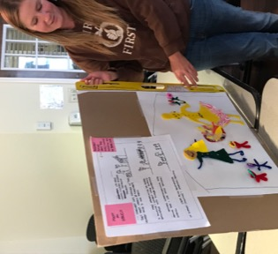
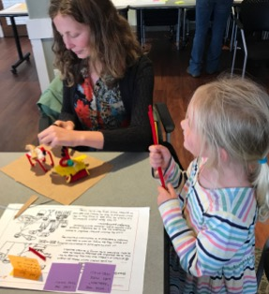
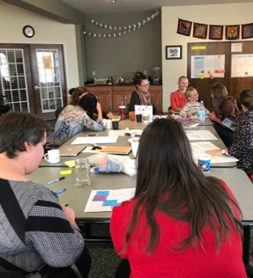
Generating ideas
Concepts
Through the empathy research, insight mining and persona development process many ideas emerged. We prioritized all the ideas and considered them through the lens of what ideas would improve or evolve the Del Norte food system, and what ideas will invent and transform the Del Norte food system in the future. Through this process we have identified six concepts that could be critical to achieving a new future experience for those interacting with the food system.
Prototyping
Prototyping is about making our ideas visible and sharing them with those interacting with the food security system and delivering the food system to learn more. A principle of prototyping is that we ‘test fast to learn fast’. Our concepts are not well formed for this purpose.

Slide 31
Improved transport options
It is hard for families and individuals to access and coordinate transport to the multiple times/locations for food access
Free grocery store/farmers market shuttle service
Align food bank and
farmers market schedules with bus schedules
Mobile farmers
market/food bank, going out into the community
City provides bikes that
can used by people to access services and appointments
Senior’s Program has volunteers to offer to drive to grocery store once per week for people who have transport challenges
Tolowa tribal transit system for community
Neighborhood-based carpooling

Slide 32
Promoting cooking, gardening, nutrition, and budgeting education
While a lot of food is available in Crescent City to those who need it, education around nutrition and how to prepare healthy, affordable meals is needed
Nutrition and cooking education in school ensures all children grow up learning how to cook
Food Box at food banks come with recipes/guidance about cooking
“Peer teaching” –
offer incentives for recipients to teach each other how to prepare food
Food education and budgeting classes allow people to save money on food, and put it away in case of emergencies
Education around what “food-based trauma” is, for foster parents, teachers, biological-parents, etc
Ensure providers are
aware of each person’s cooking facilities so food boxes etc can be tailored to people’s circumstances
Foster a grandparent program connects elders with school gardens. Program can include harvesting traditional plants. Tribal Elders teach traditional foods/cooking/budgeting
to tribal youth. Connect with school children to do
gathering as a project

Slide 33
Well-designed access points and services provided
Food assistance services are complicated and difficult to access, leaving people hungry at the end of the month when they run out of food resources
Affordable housing with kitchens available
Food services app with reminders and information
Post office, food bank, or
an empty building in Crescent City providing a place to store belongings
Securing elk hunting permission from CA DFW. Work with State and National Parks to allow foraging by tribal members
Open a homeless shelter (religion-free space)
Resources in the community (hotels, community members) for temporarily housing people in need
“Tools library” where people can borrow a can opener, pots/pans, etc.
Food Bank offers “no cook” box option. Including small cooking tools that could help prepare the food
Head Start parent
support group
Workplace flexibility and/or out of work opening hours for services
Peer support group. Specialized group for
foster children

Slide 34
Enduring provider capability
Local food services struggle to sustainably maintain volunteer support and funding.
Food Security Taskforce group is formed where leaders of all food security groups come together to meet quarterly
Food Security Taskforce is able to lobby the city of Crescent City and Del Norte County for continued funding and staff support
Food Security Taskforce is able to lobby the state and federal governments continued support for food security programs
Food security groups working in Del Norte are able to share with one another when they have excess food
Food Security Taskforce is able to coordinate food pick ups for multiple organizations
Transportation to pick up large food orders is coordinated amongst multiple food security groups working in Del Norte
Volunteer email list and Facebook group created to advertise food security related volunteer opportunities
Multiple food security groups working in Del Norte are able to form partnerships and collaborate on state and federal grant applications to bring more food security funding into Del Norte

Slide 35
Enhanced benefit user experience
Understanding, applying/reapplying for, and trying to make monthly benefits last is a constant struggle for people. The redemption experience can be disempowering for individual and families
Benefits are given out
twice a month instead of once a month
Families are aware of all food resources that are available to them
More food assistance services are available in evenings and on weekdays
WIC experience is more user friendly
Develop food guidelines for visitations. Consult with
biological parents, foster parents, supervisors. Have visitation at a meal time (no conflict with foster meals)
Specific calendars for service type (e.g. homeless, family with young children, etc.)
are available. Waterproof versions for handing out and posting outdoors. Multilingual list
of all food access services available in Del Norte, including seasonal programs

Slide 36
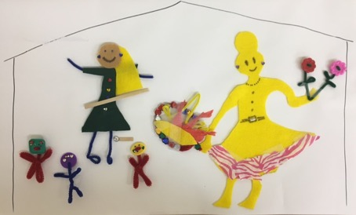
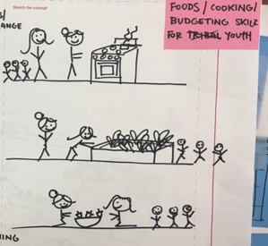
“Adopt an Abuela”
Our thrifty Elder teaches younger Mom’s about traditional foods, cooking, and budgeting skills
Life skills, cooking, cultural exchange mentorship program
A thrifty Elder gets matched with an exhausted juggler. They meet weekly at the Elder’s nearby house to cook meals together.
We are wanting to make opportunities for Elders to socialize and connect while sharing knowledge with younger generations - reducing their sense of isolation and enabling them to give back to their community.
It might work by matching intergenerational pairs around teaching and sharing food and life skills.
So that families and individuals build relationships of ongoing support and learning.

Slide 37
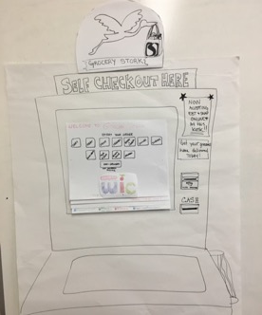
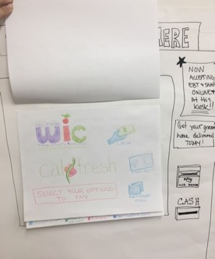
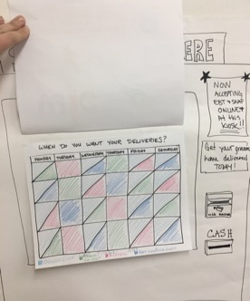
Grocery Stork
Home delivery of groceries that accommodates WIC and EBT/SNAP benefits and people without internet access. Free access for recipients of benefits
Parents, especially using WIC and SNAP, have trouble getting groceries home or even getting to the store
We need: An easy and convenient access to the food families’ need, when they need it.
We provide: A portal to connect with various options and a way to get food delivered to the home.
So that: Parents can get all the groceries they need in less time; giving them more time to spend with kids and cooking.

Slide 38
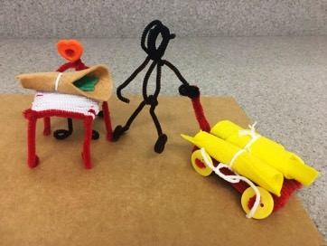
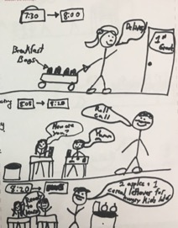
Breakfast for all students
Concept name:
What’s it like:
Each student receives a healthy breakfast at school and has plenty of time to eat in a relaxed environment with their teacher and other children
4th grade student named Thomas gets dropped off
at school at a different time each day. Some days he has time to eat breakfast but some days he arrives
at school too late. He often misbehaves in class in the morning if he misses breakfast
We need: to make sure breakfast is an essential part of the school day as it sets a child up for their day of learning.
So that: students are more able to clearly focus on their school work, there is less disruptions in class and so that teachers don’t need to purchase snacks using their own money.
We provide: a school day structure that prioritizes breakfast to ensure that all students are able to eat breakfast before their school day starts. School nutrition program revenues increase due to increased breakfast participation.

Slide 39
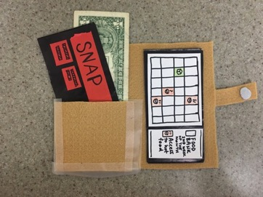
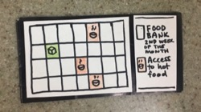
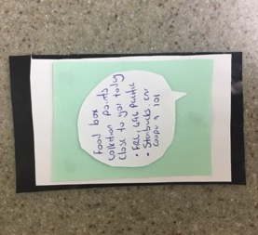
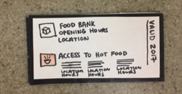
Food Access Calendars
Concept name:
What’s it like:
Food assistance services are complicated and difficult to access, leaving people hungry at the end of the month when they run
out of food resources
Food access calendars aim to make it easier to understand what is available to them, when they can access this help and where they need to go
We need: To make it easier for families, elders and homeless community members to access food resources.
We provide: All partnering agencies agree to send updates to the agency in charge of these calendars. The responsible agency can rotate every six months to share the work. Ideally you would have the calendar set for every six months so that the timetable doesn’t need to change.
We provide: Access calendars to different groups so they know when and where they can access food resources around the county. The product could look different for each group and would be bi-lingual. For example, maybe there is a text service for busy parents or a waterproof yearly card for the homeless.
So that: All community members will have access to up-to-date food resources in Del Norte.

Slide 40

Innovation change horizons
Framework Copyright ThinkPlace Ltd ™
Priority food security concepts mapped against a change horizon framework
Improving today
Creating tomorrow
improving
evolving
inventing
transforming
Services accessibility
Key services providing flexible opening hours for parents and individuals (outside standard work hours)
Workplace flexibility Employers support employees to spend critical time with their children
Healthy breakfasts with flexible eating times for all students
Students eat their healthy breakfast options in their classroom during roll call (8.05-8.20am)
Stress busters
Schools provide a safe, stable environment
where learning is meaningful and fun
Grocery Stork
Free home delivery of groceries for WIC, ETB, SNAP beneficiaries
Twice-monthly benefit cycle
Move from benefits being paid on a monthly basis, to twice a month
Food access calendars
Specific online, app and printed calendars to direct families, elders and homeless community members
to food resources
Texting program Connects families to local resources and programs
Adopt an Abuela
Life skills, cooking and cultural exchange mentorship program
Key
These concepts could link to and leverage off the literacy project (3Read23):
Specific initiative

Slide 41
Where to next
Three action steps have been identified to mobilize our food security research findings.
Findings Socialization
Reaching food security in Del Norte will require collaboration from numerous nonprofit, governmental, business, and academic groups. To gain support and action from these groups, we will present our research findings at numerous board meetings and open community meetings. Del Norte’s community will only be able to rally around increasing food security if it understands the nature and severity of Del Norte’s current food security challenges.
Step
1
Formation of Food Security Taskforce
To move from research into action, the Community Food Council will form a Food Security Taskforce. This group will include representatives who helped conduct our food security research as well as representatives from other groups who play key roles in Del Norte’s food security system. The goal of this group will be to further prototype and test innovations that respond to our research findings.
Step
2
Prototype Implementation
Each group on the Food Security Taskforce will implement at least one of of the prototyped research responses. For the Community Food Council, this will involve opening a choice-based food pantry at the Family Resource Center. As a group, the Food Security Taskforce will help to iterate and refine these prototype trials.
Step
3

